Slide 1

Forecasting Weather with SpectralSVR

Slide 2

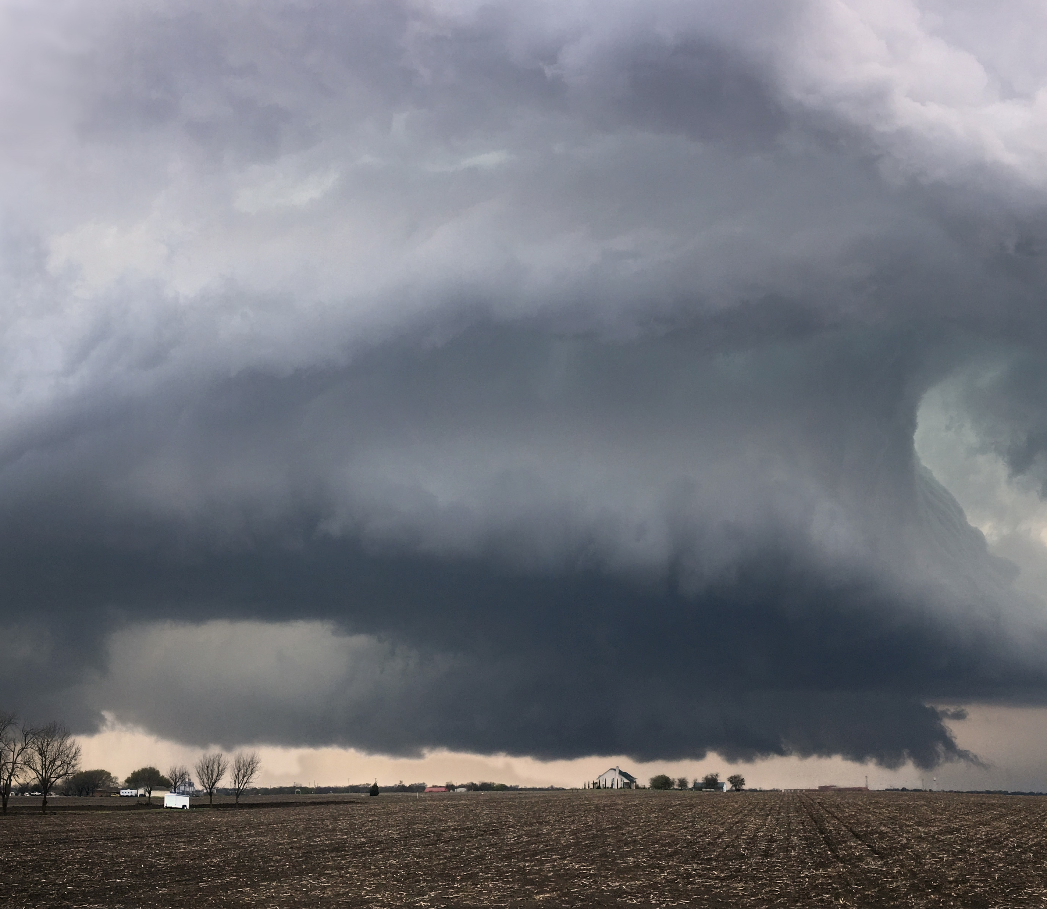

The Weather
The impact of weather on the lives of countless people continues to be a concern to many.
The very real threat of climate change has made knowledge of the subject more important
The weather affects humans on many scales, from small choices of where to eat individuals may make all the way to natural disasters that can affect peoples lives to an irreparable degree

Slide 3
Current Methods
Established methods currently used by governments and institutions rely on both numerical solvers and more data driven approaches for details
These methods are often ensembles to account for the uncertainty still present in predictions by these methods
The scales at which weather systems operate at vary greatly. This makes fine grids and temporal steps necessary, both of which are very costly

Slide 4
Spectral SVR
Strong mathematical guarantees of SVR
Interpretability of which data points during training is important to outputs
Predictions are in the form of basis function coefficients
This means separate modes (higher/lower frequency) can be analyzed separately
Very little literature on the use of support vector machines for operator learning

Slide 5
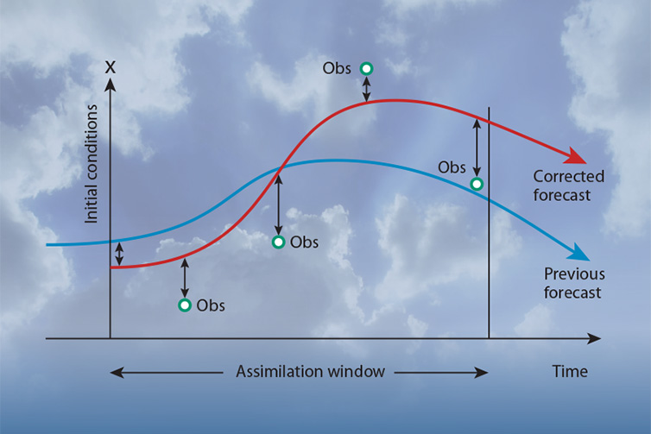
ERA5 Dataset¹
5th generation reanalysis produced by the European Centre for Medium-Range Weather Forecasts (ECMWF)
The atmospheric reanalysis has a horizontal resolution of 0.25° x 0.25°
The vertical resolution is divided by 137 levels from the surface to 80km in altitude
This dataset covers the period from 1940 to the present
The dataset is produced using model predictions that is combined with observations

Slide 6
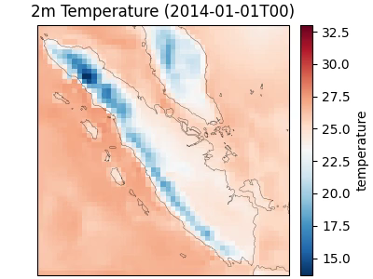

Slide 7
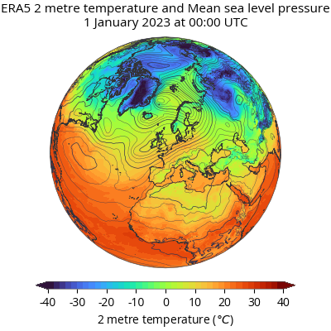
ERA5: 2m Temperature
The ERA5 dataset provides values of many different variables including atmospheric temperature at 2 meters (2m Temperature) of altitude
Our aim is to predict this variable based on this and several other variables which are:
10m wind components
Surface pressure
Mean sea level pressure
Column water vapor

Slide 8
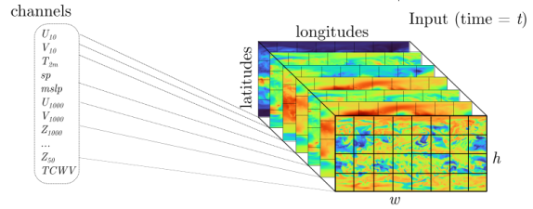
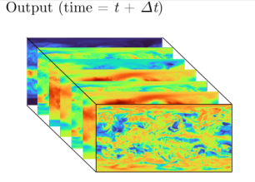
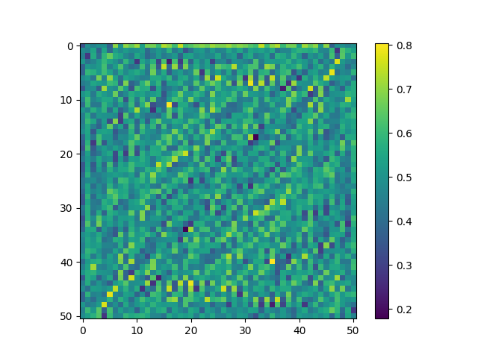
Computation Scheme: 2m Temp
SpectralSVR
F
F⁻¹

Slide 9
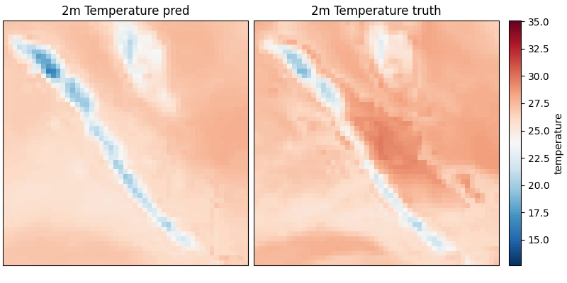
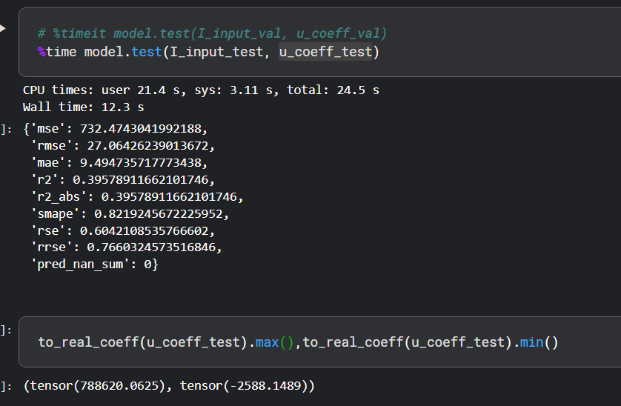
2-hour lead time

Slide 10
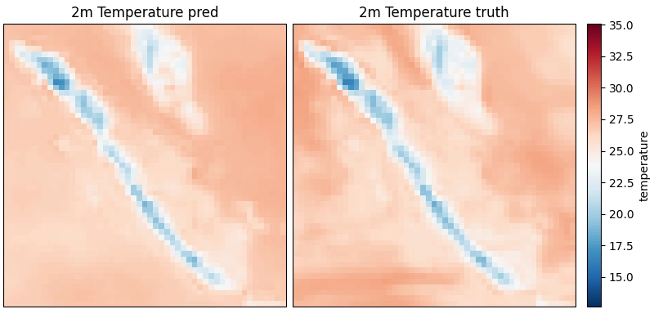
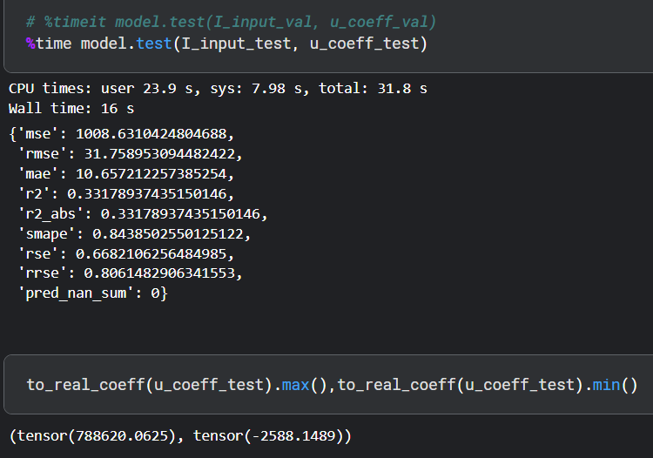
16-hour lead time

Slide 11
Improved Computation Scheme: 2m Temp
SpectralSVR
F
F⁻¹

Slide 12
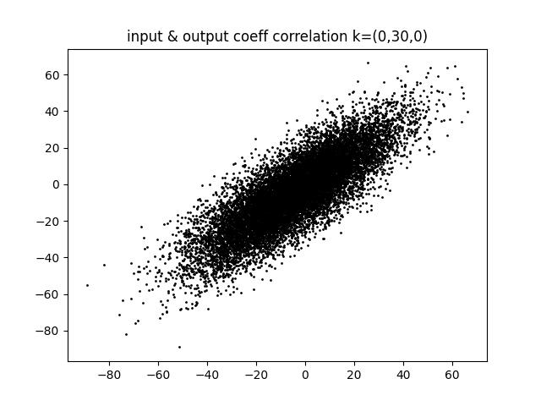
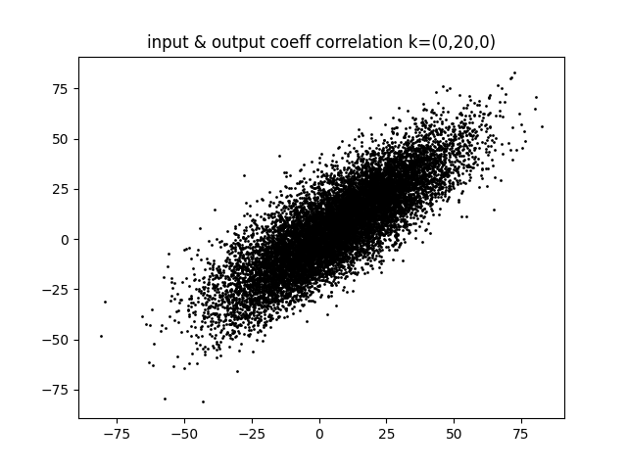
Coefficient plot between input and output

Slide 13
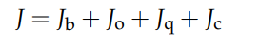
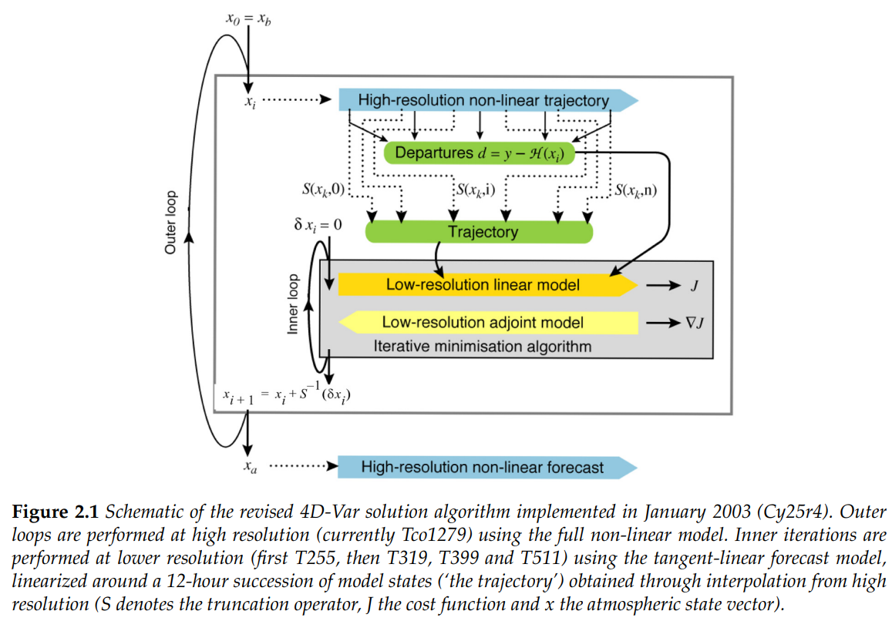
Simplified explanation of ERA5 model & observation assimilation process
Jb: discrepancy with a short-range forecast started from the previous analysis
Jo: discrepancy with the observations
Jc: discrepancy with “model error”
y: observation

Slide 14
Data assimilation is based on the method used by numerical weather prediction centers, where every so many hours (12 hours at ECMWF) a previous forecast is combined with newly available observations.
This is done in an optimal way to produce a new best estimate of the state of the atmosphere, called analysis, from which an updated, improved forecast is issued.
Reanalysis works in the same way, but at reduced resolution to allow for the provision of a dataset spanning back several decades.

